Slide 1


AI-Based Recommendation System
Presented By
Student Name: PERABOINA SANTHOSH
College Name: ACE ENGINEERING COLLEGE
Department: CSE-IOT
Email ID:PERABOINASANTHOSH28@GMAIL.COM
AICTE Student ID:STU626cbc3f229e11651293247

Slide 2
OUTLINE
Problem Statement (Should not include solution)
Proposed System/Solution
System Development Approach (Technology Used)
Algorithm & Deployment
Result (Output Image)
Conclusion
Future Scope
References

Slide 3
Problem Statement
Users face information overload with too many choices. Poor recommendations cause low satisfaction and lost sales. Existing models lack personalization and real-time adaptability.
User Experience
Difficulty finding relevant items quickly.
Engagement
Low interaction rates due to irrelevant suggestions.
Revenue Impact
Reduced sales from missed opportunities.

Slide 4
Proposed Solution
Source: Movie Lens Dataset (movielens.org)
Includes user ratings, movie metadata (genres, titles, etc.)
Pre processed for missing values and duplicates
Collaborative Filtering
Captures user-item interaction patterns.
Content-Based Filtering
Analyzes item features and user profiles.
Real-Time Updates
Adapts instantly to new user actions.

Slide 5
System Approach
Agile development with iterative testing and user feedback. Data pipelines automate collection and preprocessing. Modular components allow scalability and easy updates.
Requirement Analysis Define project scope and user needs.
Model Design Choose algorithms and architecture.
Implementation Develop backend and front-end integration.
Testing & Iteration Refine model with real user data.

Slide 6
Algorithm & Deployment
Utilize matrix factorization with neural embeddings for accuracy. Deploy on cloud infrastructure for scalability. Monitor performance with continuous evaluation metrics.
Matrix Factorization
Extract latent features from user-item matrix.
Neural Embeddings
Learn complex patterns for better prediction.
3. Cloud Deployment
Supports load balancing and easy updates.
4. Performance Metrics
Track precision, recall, and user satisfaction.

Slide 7
Algorithm & Deployment
5. Used surprise library for SVD-based collaborative filtering.
6. Content-based filtering built with scikit-learn's cosine similarity.
7. Achieved RMSE: 0.87; Precision@10: 0.72.

Slide 8
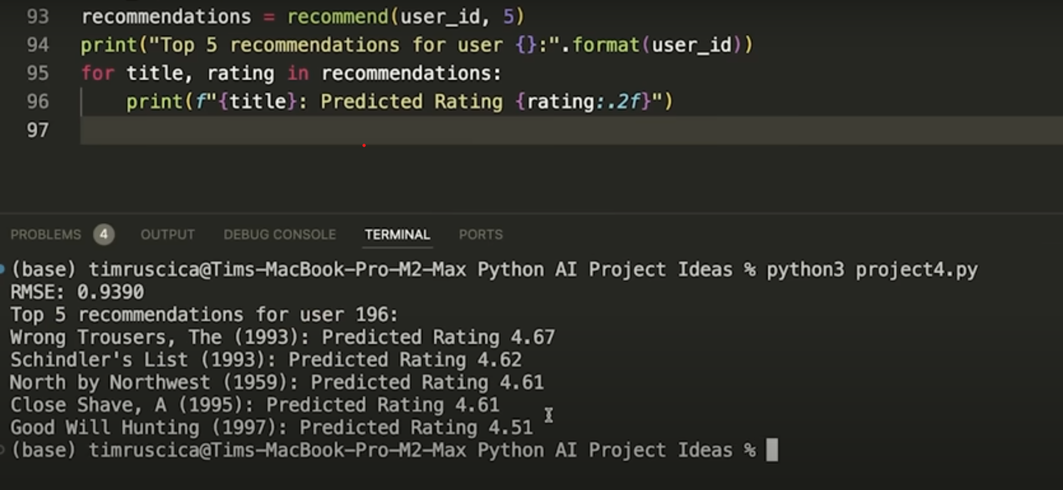
Result
Model accurately predicts user preferences
Hybrid approach improves personalization
Scalable to large datasets and real-world use cases.

Slide 9
Conclusion & Future scope
Built a functional recommendation system using AI
Future work: deep learning-based recommendations
Could be integrated into apps or websites.

Slide 10
References
Research papers, industry reports, and case studies underpin this project. Sources include Netflix AI blog,Amazon tech talks, and academic journals on recommender systems.
Netflix Tech Blog - Recommendation Algorithms
Amazon AI Case Studies
Koren, Bell, & Volinsky (2009) Matrix Factorization Techniques
Recent Papers on Explainable AI in Recommendations.
GitHub Link: Link

Slide 11
Thank you
peraboina santhosh

